Slide 1
Churn Prediction for Institutional Investors
Business Context
Client is global investment company and the largest active asset manager in the UK, with investments in equities, multi-asset, fixed income, real estate and private markets.
Assets
Funds
Manages assets about ~$670 BN
Mandates
Operates 30+ funds
2.5k+ unique mandates with AUM >1m
Investment Capabilities
Manages assets Over 10+ asset classes
Objective
To improve the accuracy of churn prediction model to mitigate disinvestment risk
←

Slide 2
Churn Prediction for Institutional Investors
DIAGNOSTICS
SOLUTION
IMPACT
Existing State:
Existing risk models were based on Relationship managers understanding of the mandate. Only 20% of all disinvestment could be accurately predicted this way.
Client was experiencing significant churn to their portfolio and post-Brexit market factors made forecasting disinvestment difficult.
Problem Statement:
Build a data driven model to predict disinvestments by considering influences like Consultant Ratings, Fund Performance, Customer interactions and transactions pattern
Provide a platform to mitigate churn risk by identifying influence of actionable factors.
←

Slide 3
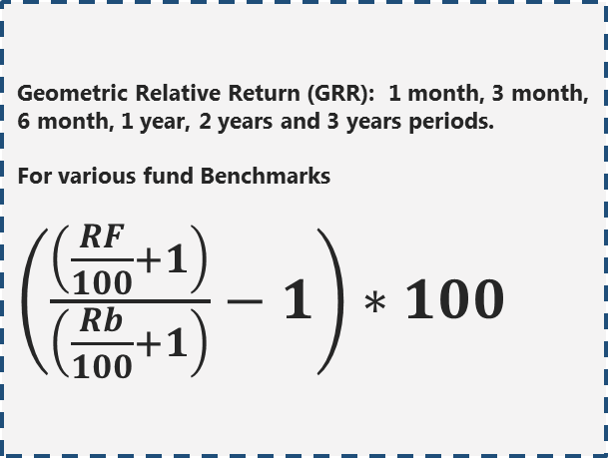
Churn Prediction for Institutional Investors
DIAGNOSTICS
SOLUTION
IMPACT
Geometric Relative Return (GRR): 1 month, 3 month, 6 month, 1 year, 2 years and 3 years periods.
For various fund Benchmarks
$\left(\frac{\left(\frac{RF}{100}+1\right)}{\left(\frac{Rb}{100}+1\right)}−1\right)∗100$
Fund Performance
Data Considered & Modelled:
Rolling 24 Month Timeline
What are we trying to predict: Disinvestment
Mandate
(size > 1mn GBP)
Money out
> = 50%
Flagged as Disinvestment
Observation Period
Disinvestment Period
12 Month window
12 Month window
Meeting: Number , Tone, Last Meeting Days. Each Captured at a 3,6,9 and 12 month period.
Cases: Different Types of Cases (Transactional, Audit, Valuation etc.), Last Case Days, Resolving Time for Cases. Each Captured at a 3,6,9 and 12 month period.
Emails: Subscriptions, Un-subscriptions, Opens Clicks etc. Each Captured at a 3,6,9 and 12 month period.
Campaigns: Number and Reach. Captured at a 3,6,9 and 12 month period.
Last days, Number of, Percentage of, Each Captured at a 3,6,9 and 12 month period, for each of the following metrics.
Money In
Money Out
Switch In
Switch Out
Transfer In
Transfer Out
Percentage Change in Aum
Mandate Consultant Rating: Weighted Scoring for a Mandate after extrapolation.
Lead Fund Consultant Rating: Score for the Lead Fund after extrapolation.
GCRM Interactions
Transactions
Consultant Rating

Slide 4
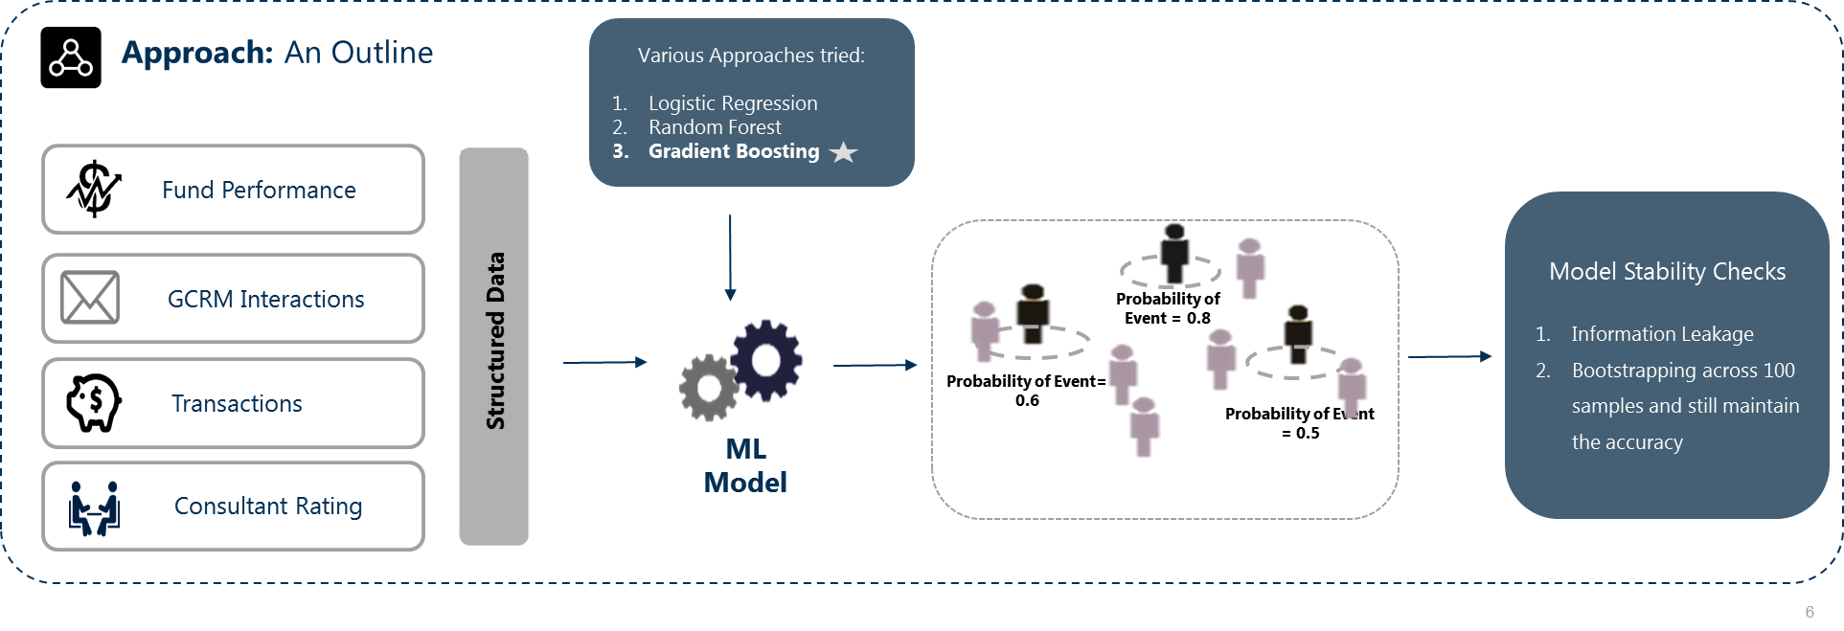
Churn Prediction for Institutional Investors
DIAGNOSTICS
SOLUTION
IMPACT
←

Slide 5
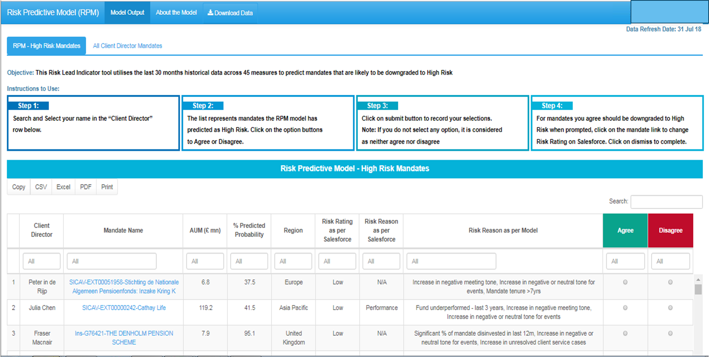
Socializing with Relationship Managers
DIAGNOSTICS
SOLUTION
IMPACT
←

Slide 6
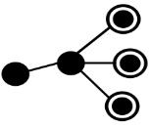




Scenario Planner
DIAGNOSTICS
SOLUTION
IMPACT
R shiny Web Tool
Relationship Manager’s Feedback
Data
Predictive Model
Model Output
Live Tracking
Senior Leadership Dashboard
←

Slide 7

Personalized Targeting using Look-Alike Modeling
DIAGNOSTICS
SOLUTION
IMPACT
Key Outcomes
45% uplift & 37% agreement with client directors on pilot testing (5 client directors)
Model stability – Bootstrapping & minimum overlap testing to prove model stability
Model performs better for AUM size < 100 m & Time to disinvest within 9 months.
Existing Approach
Relationship Managers decided based on their instincts on the mandate
Business Impact
Considering data driven approach resulted in higher risk mitigation
Transactions and Interactions Data
LatentView Approach
Classification Model
Provided Additional Savings (~$3 bn)
Fund Performance
+?%
Consultant Ratings
Additional Model Accuracy
←
+45%

